Slide 1
Car Price Prediction Project

Slide 2
Contents
Problem Statement
Introduction
Analytical Problem Framing
Models Development and Evaluation
Analysis of the output of each model
Conclusion

Slide 3
Problem Statement
Scrape at least 5000 used cars data. After collecting the data, build a machine learning model. Before model building do all data pre-processing steps. Try different models with different hyper parameters and select the best model.

Slide 4
INTRODUCTION
Business Problem Framing
From a long time since being, a continuous paradigm of transactions of commodities has been into existence. Earlier these transactions were in the form of barter system which later was translated into a monetary system. And with consideration into these, all changes that were brought about the pattern of re-selling items was affected as well. There are two ways in which the re-selling of the item is carried out. One is offline and the other being online. In offline transactions, there is a mediator present in between who is very vulnerable to being corrupt and make overly profitable transactions. The second option is online wherein there is a certain platform which lets the user find the price he might get if he goes for selling.
Kilometers traveled – We know that the number of kilometers traveled by a vehicle has a huge role to play while putting the vehicle up for sale. The more the vehicle has traveled, the older it is.
Year of registration – It is the year when the vehicle was registered with the Road Transport Authority. The newer the vehicle is; the better value it will yield. By every passing year, the value will depreciate.
Fuel Type – There were two types of fuel types present in the dataset that we had. Petrol and Diesel. It was relatively less dominant.
It's due to the above factors that we need a system that can develop a self-learning machine learning-based system. This was the basis on which a set of objectives was supposed to be formulated. One thing that was pre-determined was that this is going to be a real-time project.

Slide 5
Conceptual Background of the Domain Problem
To build a supervised machine learning model for forecasting value of a vehicle based on multiple attributes.
The system that is being built must be feature based i.e. feature wise prediction must be possible
Review of Literature
In this project, we discuss various applications and methods which inspired us to build our project. We did a background survey regarding the basic ideas of our project and used those ideas for the collection of information like the technological stack, algorithms, and shortcomings of our project which led us to build a better project.
1)CARS24
Cars24 is a web platform where seller can sell their used car. It is an Indian Start-up with a simplified user interface which asks seller parameters like car model, kilometers traveled, year of registration and vehicle type (petrol, diesel). These allow the web model to run certain algorithms on given parameters and predict the price.
2)GET VEHICLE PRICE-
Get Vehicle Price is an android app which works on similar parameters as of Cars24. This app predicts vehicle prices on various parameter like Fiscal power, horsepower, kilometers traveled. This app uses a machine learning approach to predict the price of a car, bike, electric vehicle and hybrid vehicle. This app can predict the price of any vehicle because of the smartly optimized algorithm.

Slide 6
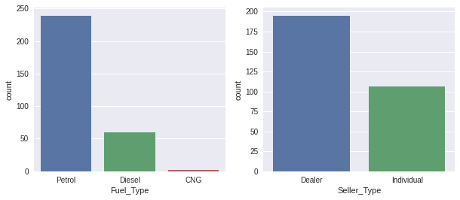
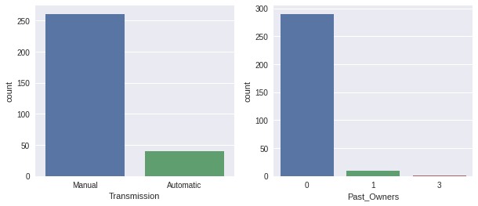
Analytical Problem Framing
Mathematical/ Analytical Modeling of the Problem-
Univariate Analysis-

Slide 7
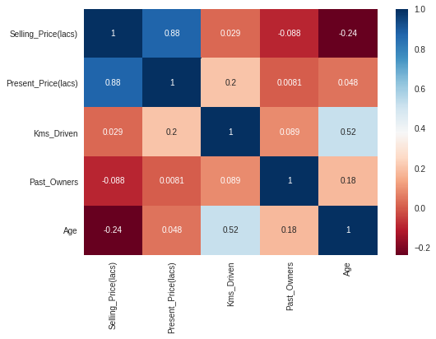
2)Multi variate Analysis-
Data Sources -
For this project, we are using the dataset on used car sales from a data analysis, Regression algorithms.
Data Preprocessing Done
In this section we plotted our data in two steps-
1)creating dummies for categorical features
2)Train-test split

Slide 8
Hardware and Software Requirements and Tools Used
Python was the major technology used for the implementation of machine learning concepts the reason being that there are numerous inbuilt methods in the form of packaged libraries present in python. Following are prominent libraries/tools we used in our project.
1)NUMPY
NumPy is a general-purpose array-processing package. it provides a high-performance multidimensional array object and tools for working with these arrays. It is the fundamental package for scientific computing with Python. Besides its obvious scientific uses, NumPy can also be used as an efficient multi-dimensional container of generic data.
Arbitrary data-types can be defined using Numpy which allows NumPy to seamlessly and speedily integrate with a wide variety of databases.
2)JUPYTER NOTEBOOK
The Jupyter Notebook is an open-source web application that allows you to create and share documents that contain live code, equations, visualizations, and narrative text. It includes data cleaning and transformation, numerical simulation, statistical modeling, data visualization, machine learning, and much more.

Slide 9
Models Development and Evaluation
Identification of possible problem-solving approaches (methods)
1)Reading and Understanding the dataset.
2)Data Preprocessing.
3) Exploratory Data Analysis
4)Model creation and Evaluation
Testing of Identified Approaches (Algorithms)
Linear Regression
Ridge Regression
Lasso Regression
Random Forest Regression
Gradient Boosting regression

Slide 10
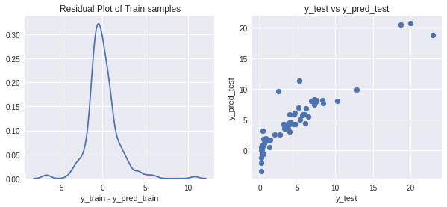

Analysis of the output of each model
Logistic Regression
2. Ridge Regression

Slide 11

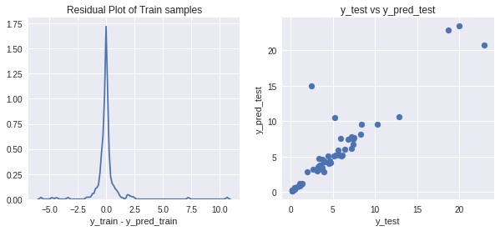
3. Lasso Regression-
4.Random Forest

Slide 12
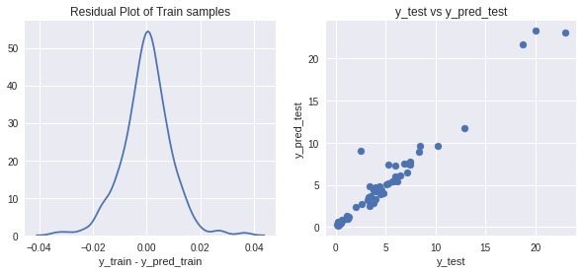
Gradient Boosting Classifier
Interpretation of the Results
 | Model | R Squared(Train) | R Squared(Test) | CV score mean(Train)
1 | LinearRegression | 0.88 | 0.86 | 0.84
2 | Ridge | 0.88 | 0.86 | 0.84
3 | Lasso | 0.88 | 0.86 | 0.84
4 | RandomForestRegressor | 0.95 | 0.82 | 0.87
5 | GradientBoostingRegressor | 1.00 | 0.94 | 0.87

Slide 13
Conclusion
Key Findings and Conclusions of the Study
Car price prediction can be a challenging task due to the high number of attributes that should be considered for the accurate prediction. The major step in the prediction process is collection and preprocessing of the data. In this project, web scraping were built to normalize, standardize and clean data to avoid unnecessary noise for machine learning algorithms.
Limitations of this work and Scope for Future Work
As a part of future work, we aim at the variable choices over the algorithms that were used in the project. We could only explore two algorithms whereas many other algorithms which exist and might be more accurate. More specifications will be added in a system or providing more accuracy in terms of price in the system.

